Slide 1
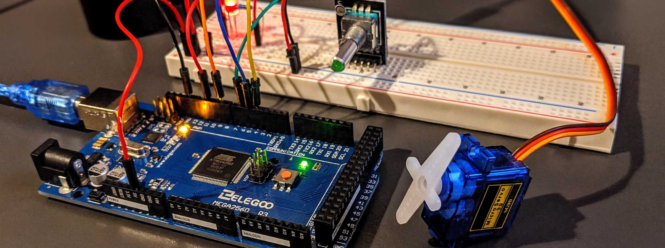




Visualizing Datapath for Different Data-Processing Instructions of a Complete Single-Cycle Processor
EEE 416 – Microprocessors and Embedded Systems Laboratory
July 2023 Level-4 Term-1
Project Update Presentation
Submitted by – Group 04
Kazi Mubashir Tazwar
1906142
Prantik Paul
1906145
Khondaker Nafis Ahmed
1906147
Manjur Muntasir
1906150

Slide 2
Outline
Summary
Introduction
Design
Implementation
Analysis and Evaluation
Reflection on Individual and Team work
Communication to External Stakeholders
Project Management and Cost Analysis
Future Work
References
Presented by: 1906142

Slide 3
1. Summary / Abstract
Purpose of this project is to achieve better understanding of the architecture of single-cycle microprocessor studied in theory course.
The diagram of a single cycle processor is fitted in two LED matrices.
The control signals are shown using LEDs, and the diagram shows the fetch and execution cycle for different instructions.
Datapath of instructions are highlighted step-by-step using different color LEDs.
Presented by: 1906142

Slide 4
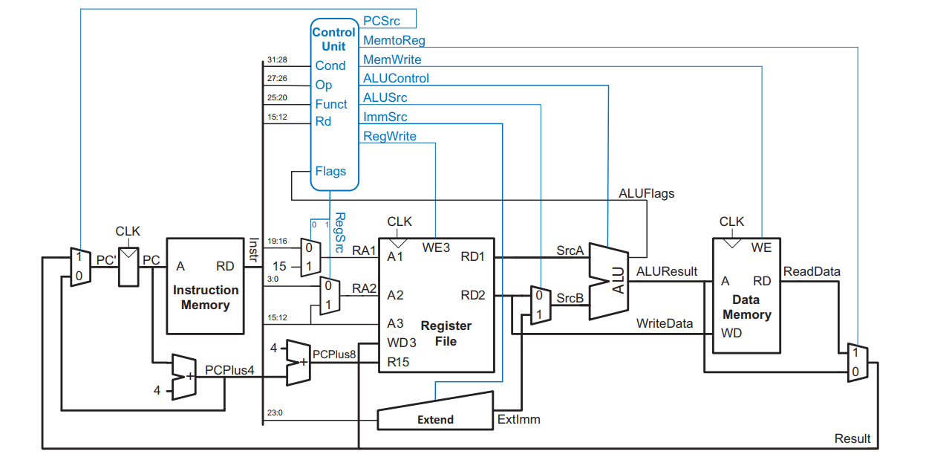
2. Introduction
A single-cycle processor is a microprocessor that carries out fetch cycle and execution cycle in a single clock cycle.
A Control Unit and
5 main blocks:
Program Counter
Instruction Memory
Register File
Arithmetic Logic Unit
Data Memory
EEE 416 (2023) – Group 4
Presented by: 1906142

Slide 5
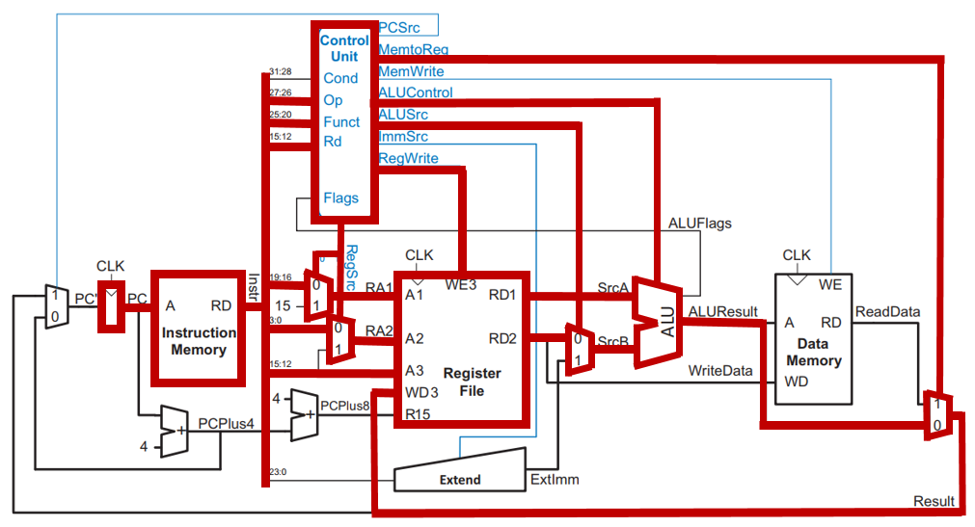
2. Introduction
Datapath for ADD Instruction (ADD R0, R1, R2)
EEE 416 (2023) – Group 4
Presented by: 1906142

Slide 6
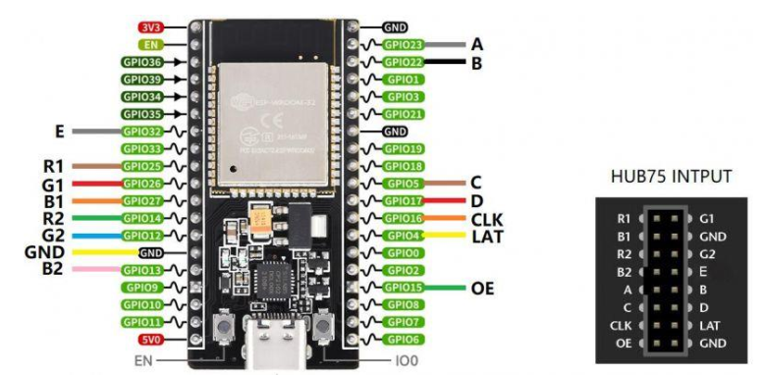
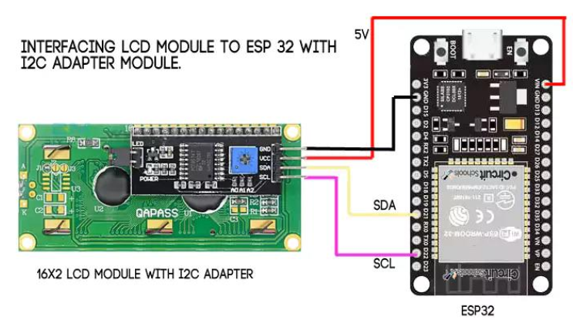
3.3 Design: Circuit Diagram
Fig.: Interfacing the ESP32 Development board (38 pin) with HUB75 input of the LED display
Fig.: Interfacing the LCD Module with I2C adapter with the ESP32 Development board
(38 pin)
EEE 416 (2023) – Group 4
Visualizing Datapath for Different Data-Processing Instructions of a Complete Single-Cycle Processor
Presented by: 1906142

Slide 7
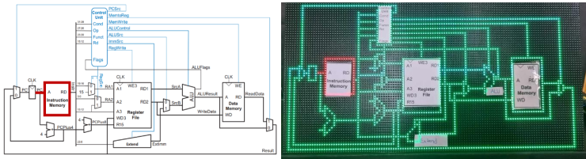
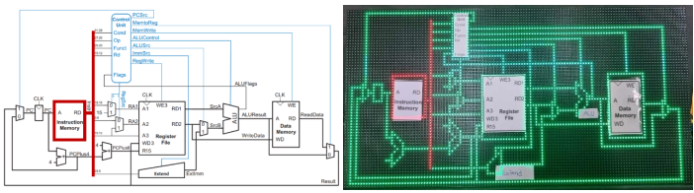
4 Implementation: Demonstration
Step – 1
Firstly, the program counter sends a signal to instruction memory indicating which line to execute
Step – 2
Instruction memory sends the data to bus
Presented by: 1906147

Slide 8
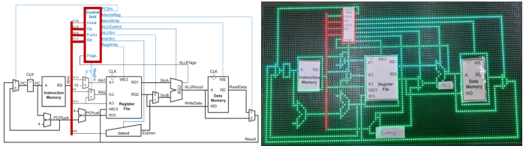
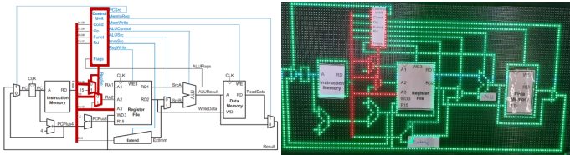
4 Implementation: Demonstration
Step – 3
Bus decodes the line to be executed and sends the corresponding Op code, Funct and Rd to the control unit
Step – 4
Bus sends the address of source and destination registers to the corresponding multiplexers. Control unit sends selection bits (RegSrc) to multiplexers
Presented by: 1906147

Slide 9
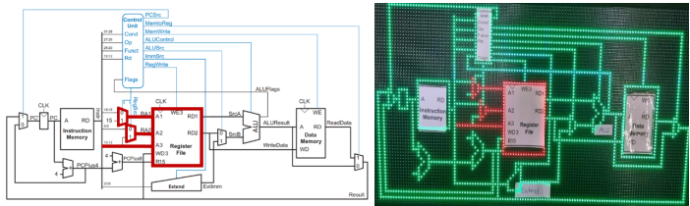
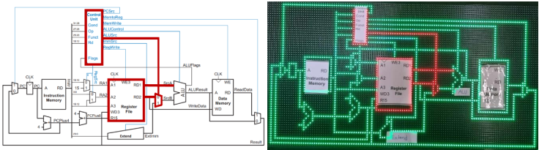
4 Implementation: Demonstration
Step – 5
Multiplexers send the address of source registers to register file and register file extracts the value from the registers
Step – 6
Register file sends the values extracted from the registers to multiplexer before ALU (RD2) and ALU (RD1). To activate the input line from register file, control unit sends signal (ALUSrc) to the multiplexer before ALU
Presented by: 1906147

Slide 10
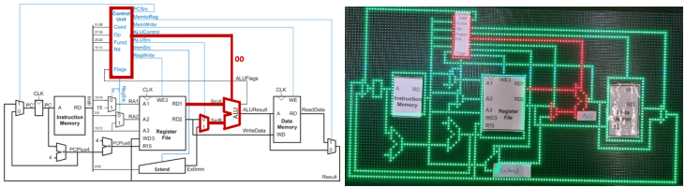
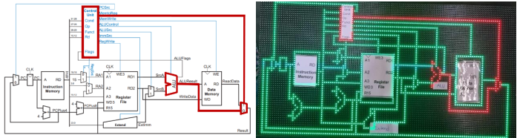
4 Implementation: Demonstration
Step – 7
The values to be added are added in arithmetic logic unit in this step. For ADD operation, control unit sends ‘00’ (ALUControl) to arithmetic logic unit
Step – 8
ALU sends the sum (output of the ALU) to the multiplexer after data memory and control unit sends ‘0’ to multiplexer to select the input coming from ALU
Presented by: 1906147

Slide 11
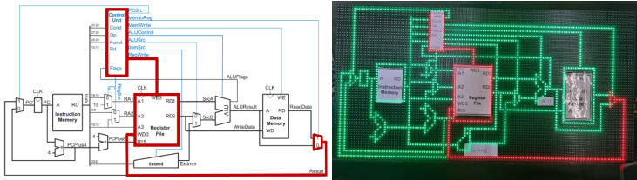
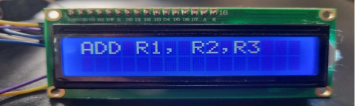
4 Implementation: Demonstration
Step – 9
Finally, the multiplexer sends the value to register file and control unit sends ‘1’ (RegWrite) to register file to enable writing operation in destination register. Register file stores the sum in the destination register
LCD Display Output
The LCD display shows the instruction from the beginning of the cycle
Presented by: 1906147

Slide 12
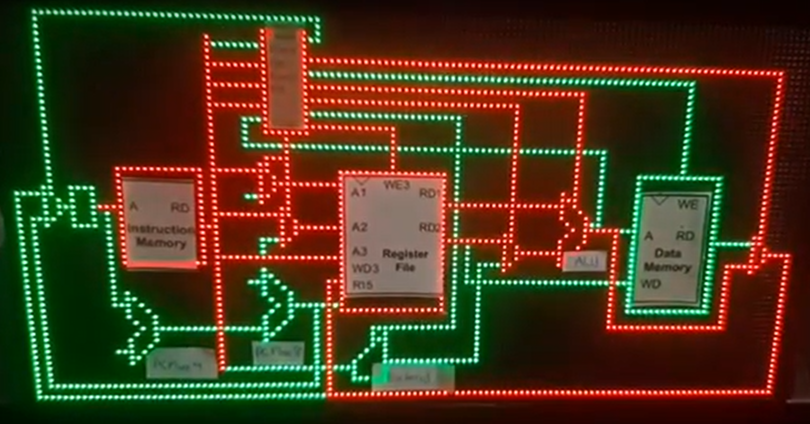
4 Implementation: Demonstration
Full Cycle
Presented by: 1906147

Slide 13
5.1 Novelty
Our goal for this project was to design a device that would help undergraduate/college students understand the datapath of a single-cycle processor for different instructions.
Our project is unique. There are no available devices that help us visualize the datapath for a single-cycle processor in the market. We used two 64x64 LED matrix and coded the entire single cycle processor onto it. Then for different instructions such as (ADD, MOV, STR), we implemented our own code to visualize their datapaths. We used existing libraries in Arduino, but the codes we constructed for all the different instructions are unique and are an original contribution.
Presented by: 1906145

Slide 14
5.2 Design Considerations (PO(c))
There were a multitude of aspects we had to take into consideration while designing our project. As previously mentioned, there were no such available devices that showcased the datapath for a single-cycle processor. Therefore, we did not have any template to base our project on. We decided to use 2 LED matrix (64x64) to help visualize the datapath. Single-cycle processor consists of many different blocks such as instruction memory, control unit, register file, ALU, MUX, extend, data memory. We provided them distinct shapes so the viewer can easily discriminate between all the different blocks. A LCD display would show the corresponding assembly language instruction corresponding to the datapath shown on the LED matrix.
Presented by: 1906145

Slide 15
5.3 Limitations of Tools (PO(e))
Our project showcases the datapath of the single-cycle processor on the LED matrix and the corresponding assembly instruction on the LCD display. We wanted to connect both the LCD display and the LED matrix using only one ESP32. But trying to run both using a singular microcontroller produced erroneous results. Our first assumption was that the disturbance on datapath shown on LED matrix while connecting both lcd and LED was because they both had to share SCL (GPIO 22) of the ESP32. This was later debunked as the LED matrix showed no disturbances while both were connected, if we didn’t implement the code to display in the lcd. This problem was left unsolved and so we decided to use two different microcontrollers (ESP32), one for the LCD and the other for the LED matrix
Presented by: 1906145

Slide 16
5.4 Impact Assessment (PO(f))
The concept of a microarchitecture and the flow of a single-cycle microarchitecture are sometimes difficult for undergraduate students to understand. It can occasionally become difficult to understand due to the multiple control signals and variety of datapaths. Sometimes a deeper comprehension of the entire process requires more than just theoretical knowledge. Our project can easily be put into practice in different universities where they offer the course “Microprocessor and Embedding System”. This project will provide assistance to students learning how the single-cycle processors work when covering this particular topic.
Presented by: 1906145

Slide 17
6.1 Individual Contribution of Each Member
The entire workload of the project was evenly distributed between all 4 group members. We were all involved in the process of formulating the design of our project, adding different components to achieve a robust structure that conveys our main goal of providing a way to visualize datapaths of a single-cycle processor. Everybody was present at the acquisition of the required components and material. The next step was to construct all the blocks and then map them to the LED matrix accordingly. After that we implemented the datapath of different instructions such as MOV, ADD, SUB, STR and simultaneously displayed the corresponding assembly language instruction on the LCD where we took equal responsibility for completing the tasks
Presented by: 1906150

Slide 18
6.2 Mode of TeamWork and Diversity
Initially our work mode was of a collaborative nature as we all were involved in formulating the design and acquiring different components. Mapping different instructions in the LED matrix required division of labor among us, changing the mode of work into a cooperative one. Then we reverted back to collaborative mode to finish assembling and providing the whole project with a firm hardware structure.
Presented by: 1906150

Slide 19
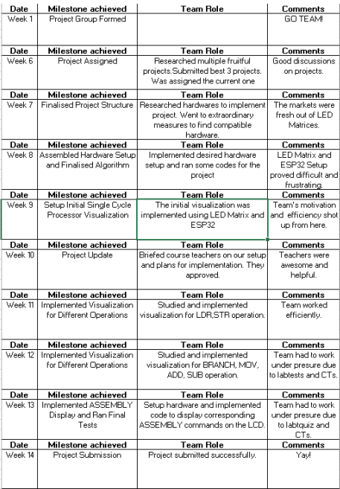
6.3 Logbook of Project
Presented by: 1906150

Slide 20
7 Communication to External Stakeholders (PO(j))
Github Link
https://github.com/KhNafisAhmed/Single-Cycle-Microprocessor-Datapath
YouTube Link
https://www.youtube.com/watch?si=mBNWvLYh7oaOY2YT&fbclid=IwAR1rCwBLpZwLIXFakjSCm05nv_lAFczTq02SvBWpnU-ZOQ18aYmOq4ZPzCo&v=__B3RJSNMj0&feature=youtu.be
Presented by: 1906150

Slide 21
8. Project Management and Cost Analysis (PO(k))
Bill of Materials
Components ESP 32 Dev board (38 pin) | Cost (Tk. Per unit) 800
LED panel | 2000
Switched mode power supply | 900
LCD display | 460
Structure and miscellaneous overhead | 1500
Presented by: 1906150

Slide 22
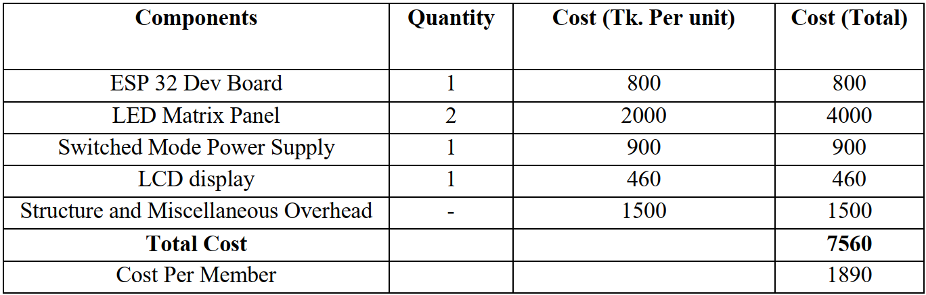
8. Project Management and Cost Analysis (PO(k))
Calculation of Per Unit Cost of Prototype
Presented by: 1906150

Slide 23
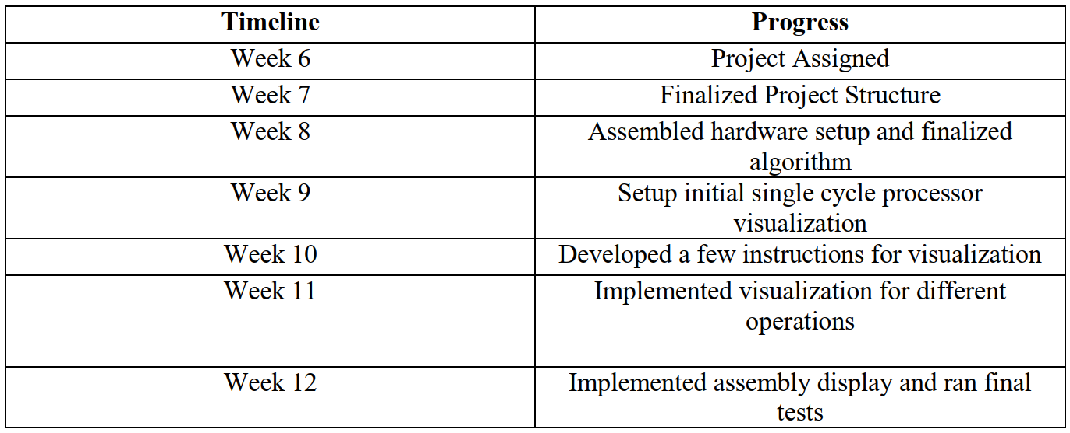
8. Project Management and Cost Analysis (PO(k))
Timeline of Project Implementation
Presented by: 1906150

Slide 24
9. Future Work
The biggest drawback of our project is the use of two ESP32, one for the LED screen and another for the LCD one. There are a few instructions that our project is missing, and we are only capable of showing our code in an infinite loop. Further work is required to create a user interface so we can only view the instruction we want to.
Presented by: 1906150

Slide 25
10. References
https://www.circuitschools.com/interfacing-16x2-lcd-module-with-esp32-with-and-without-i2c/?fbclid=IwAR1SXnwuzfOeIbRRPZtAe69jwHGajmTidegC9nIqLZVURAm2q96QmY9ItZo
https://www.waveshare.com/wiki/RGB-Matrix-P3-64x64?fbclid=IwAR3mHo6NqsroI69KENnQi5vh-3ygSMBO6GQOB44v6gsuyPR48IqPVVLyy40
Presented by: 1906

Slide 26
THANK
YOU
Presented by: 1906

